Slide 1
Dabbling in the Data
Summer Matters Leadership Conference
Stephanie Kong & Jessica Manta-Meyer | January 2016

Slide 2
Today!
Hands-on practice with data analysis
Inside our guide
Applications to your work

Slide 3
In the Guide…

Slide 4
Spotlight Activities
Mind the Gap
Yarn Slope Graph
Magic Quadrant

Slide 5
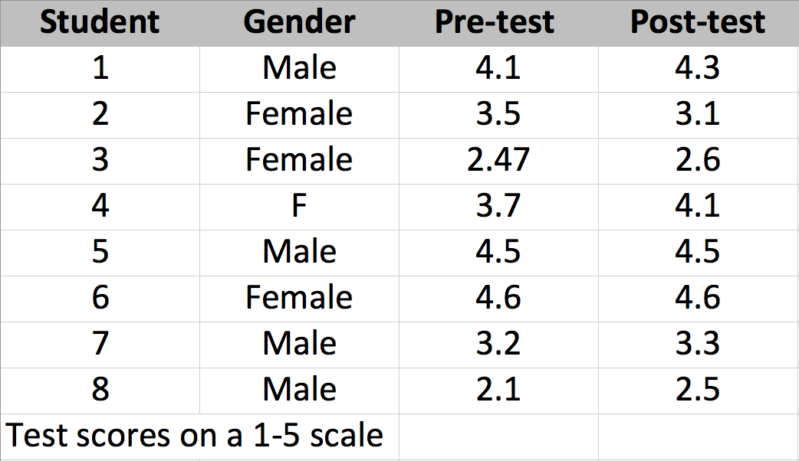
Mind the Gap: Sample Data Set

Slide 6
Mind the Gap: Ready, Set…

Slide 7
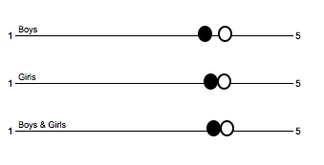
Mind the Gap: Analyze!

Slide 8
Mind the Gap: Practice
Site Name | Neighborhood | % Youth Attending 15+ Days
Stark Elementary | North | 90%
Martell Middle | South | 75%
Baratheon Elementary | South | 25%
Arryn Middle | North | 30%
Mormont Elementary | North | 45%

Slide 9
Yarn Slope Graph: Sample Stories
Corey’s Craft Camp
Best Program Ever!
Play in the Park

Slide 10
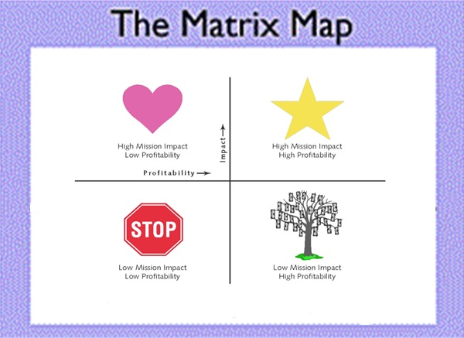
Magic Quadrant: Example

Slide 11
Magic Quadrant: Practice
Goal:
Give youth more leadership opportunities in program.
Potential Solutions:
Have youth do icebreakers
Send all staff to Youth Works Methods workshops
Observe all staff and give them a sticker for every time you see them let youth lead
Buy more books on leadership
…
…
…
Effort
Impact

Slide 12
Data Analysis in 3…2..1…Blast Off!
How might these approaches be useful in your work?
What is the activity you’re most excited about to bring back to your team?

Slide 13
Thanks & Keep in Touch!
Stephanie Kong| stephanie@publicprofit.net
Jessica Manta-Meyer| jessica@publicprofit.net
www.publicprofit.net | 510.835.1669

